Slide 1
The Heart Of Leadership
Building Strong Relationships

Slide 2
Lead The Field Be Different

Slide 3
Show BeVera’s Heart
Our heart is what makes us stand out and be the Leaders and have people wanting to follow us. That’s when you know you’ve moved out of position “1”. In that position, people follow you because they have to follow you. You’re their Supervisor or you work in HR or have some prestigious title.
We want others to follow because they respect, trust and see our integrity.

Slide 4
Relationship is the Foundation of Leadership
Leadership is built in Relationship. You can not lead someone that doesn’t understand or trust you.

Slide 5
The Integrity Of The Heart

Slide 6
Person Of Integrity
BeVera’s Definition
Integrity may have different meanings for different people
Conducting honest business
Valuing the power of the truth
Relying on the truth
Do what you say you will do
1
Be a person of your word
2
Have integrity of the heart
3

Slide 7
Leadership
Leadership is the capacity to influence others through inspiration. That inspiration comes from a passion which is motivated by a sense of Vision and a sense purpose. So, leadership is very personal. Leaders actually pursue a passion towards a purpose that gives them a sense of destiny.

Slide 8
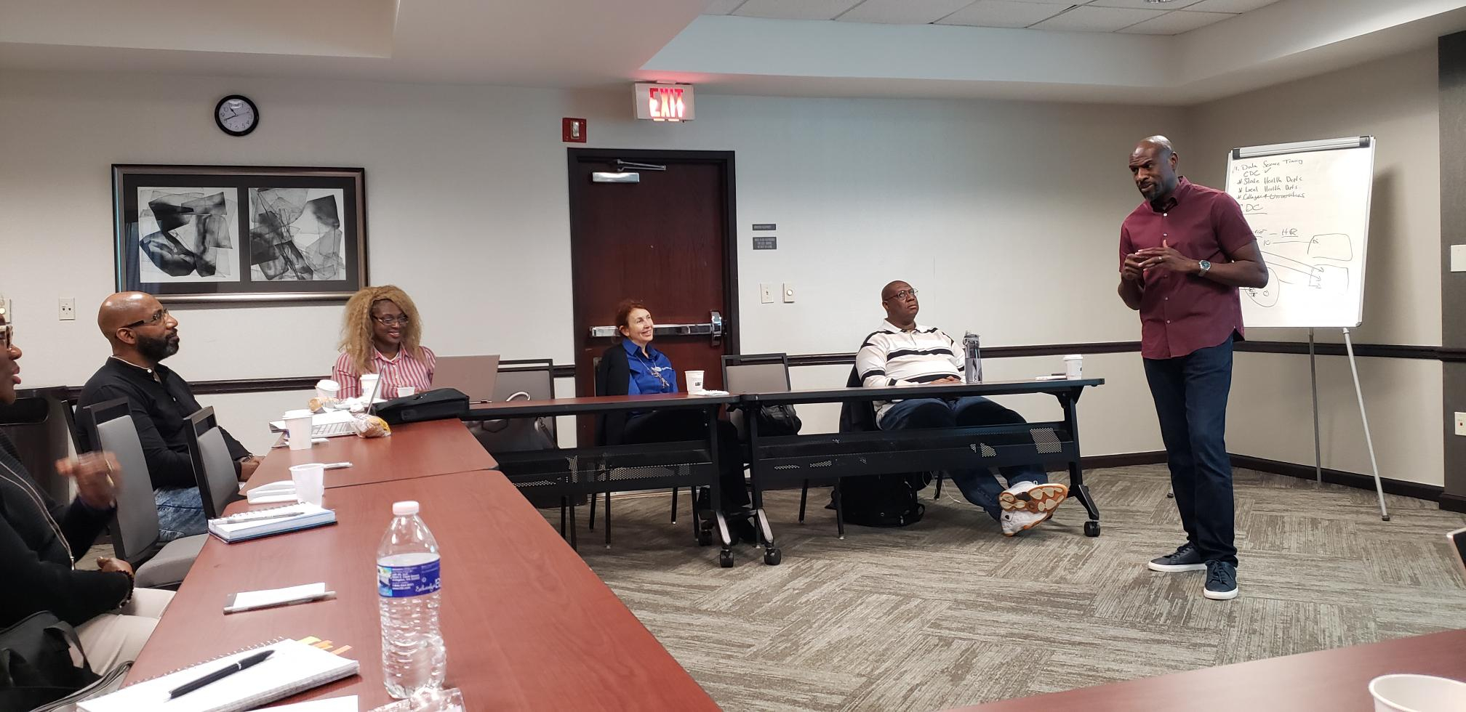
Presence and Absence
Leadership is about making others better as a result of your presence and making sure that impact lasts in your absence.
It’s called Caring, Trust, Valuing and Integrity of the heart for people.

Slide 9
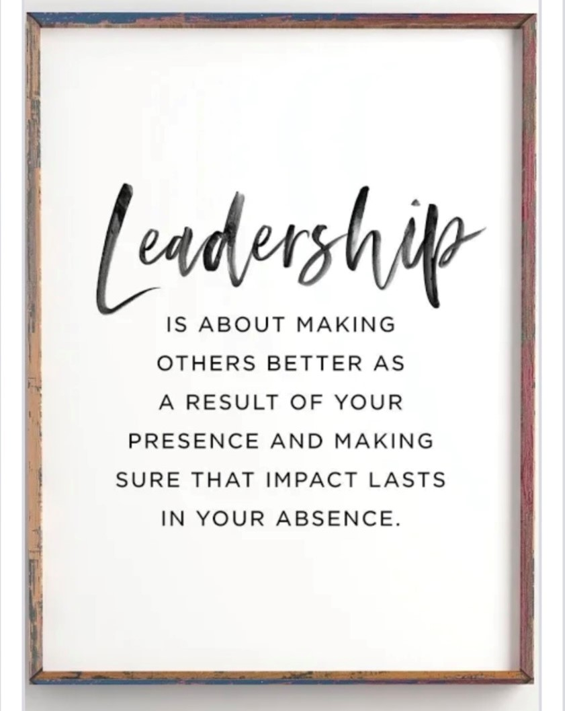
Books to Develop your Leadership
The Heart Of Leadership – Mark Miller
The Art Of Caring Leadership – Heather R. Younger
Heart – Leadership – Ian J. Berry
Leadership after God’s Own Heart – Jim George
Books by Myles Munroe
Books by John Maxwell

Slide 10
Leaders & Builders of BeVera, our CEO’s
Vincent Lott and his beautiful Wife Tracy Lott.

Slide 11
This Ends My Presentation Thank You for your participation!
Questions, Comments are welcome!!!!

